Slide 1

TEAM DETAILS
Team Name - PRIME'S CHOSEN THREE
Team Leader Name - NAVEENKUMAR T
Problem Statement - Dynamic AI Workload Orchestrator for Energy-Aware High-Performance Computing Clusters

Slide 2

Brief about the idea
PROBLEM :
Modern AI and HPC workloads consume massive energy.
Current schedulers optimize only for performance — not energy efficiency, carbon footprint, or thermal impact.
This leads to high operational costs and environmental impact.
PROPOSED SOLUTION :
A software-based intelligent orchestration system that dynamically schedules AI/HPC workloads by
OPTIMIZING :
⚡ Energy Consumption
🌱 Carbon Intensity
🚀 Performance (SLA compliance)
🌡 Thermal Balance
USING :
Predictive AI models for workload & power estimation
Reinforcement Learning / Multi-objective optimization
Real-time carbon intensity data

Slide 3
Opportunities :
🌍 Rising global demand for sustainable AI & green data centers
⚡ Increasing energy costs in large-scale AI training
🏢 Enterprises seeking carbon-neutral computing solutions
☁️ Cloud providers aiming for energy-aware workload management
📈 Growing regulatory pressure on carbon reporting & efficiency
🤖 Rapid Expansion of Large AI Models (LLMs & Foundation Models)
💰 Need for Cost-Efficient Infrastructure Utilization
📊 Demand for Real-Time Energy & Performance Transparency

Slide 4
List of features offered by the solution
⚡ Energy-Aware Scheduling Allocates workloads to minimize total power consumption.
🌱 Real-Time Carbon-Aware Decisions Integrates live carbon intensity data to reduce emissions.
🧠 AI-Based Workload Prediction Forecasts resource usage and power demand before execution.
🎯 Multi-Objective Optimization Engine Balances performance, energy, carbon footprint, and thermal stability.
🔁 Self-Learning Reinforcement Scheduler Continuously improves decision-making over time.
🌡 Thermal Load Balancing Prevents node overheating and reduces cooling overhead.
📊 Live Monitoring & Analytics Dashboard Displays energy savings, carbon reduction, and performance metrics.
🔄 Dynamic Workload Reallocation Automatically migrates jobs to more efficient nodes when needed.

Slide 5
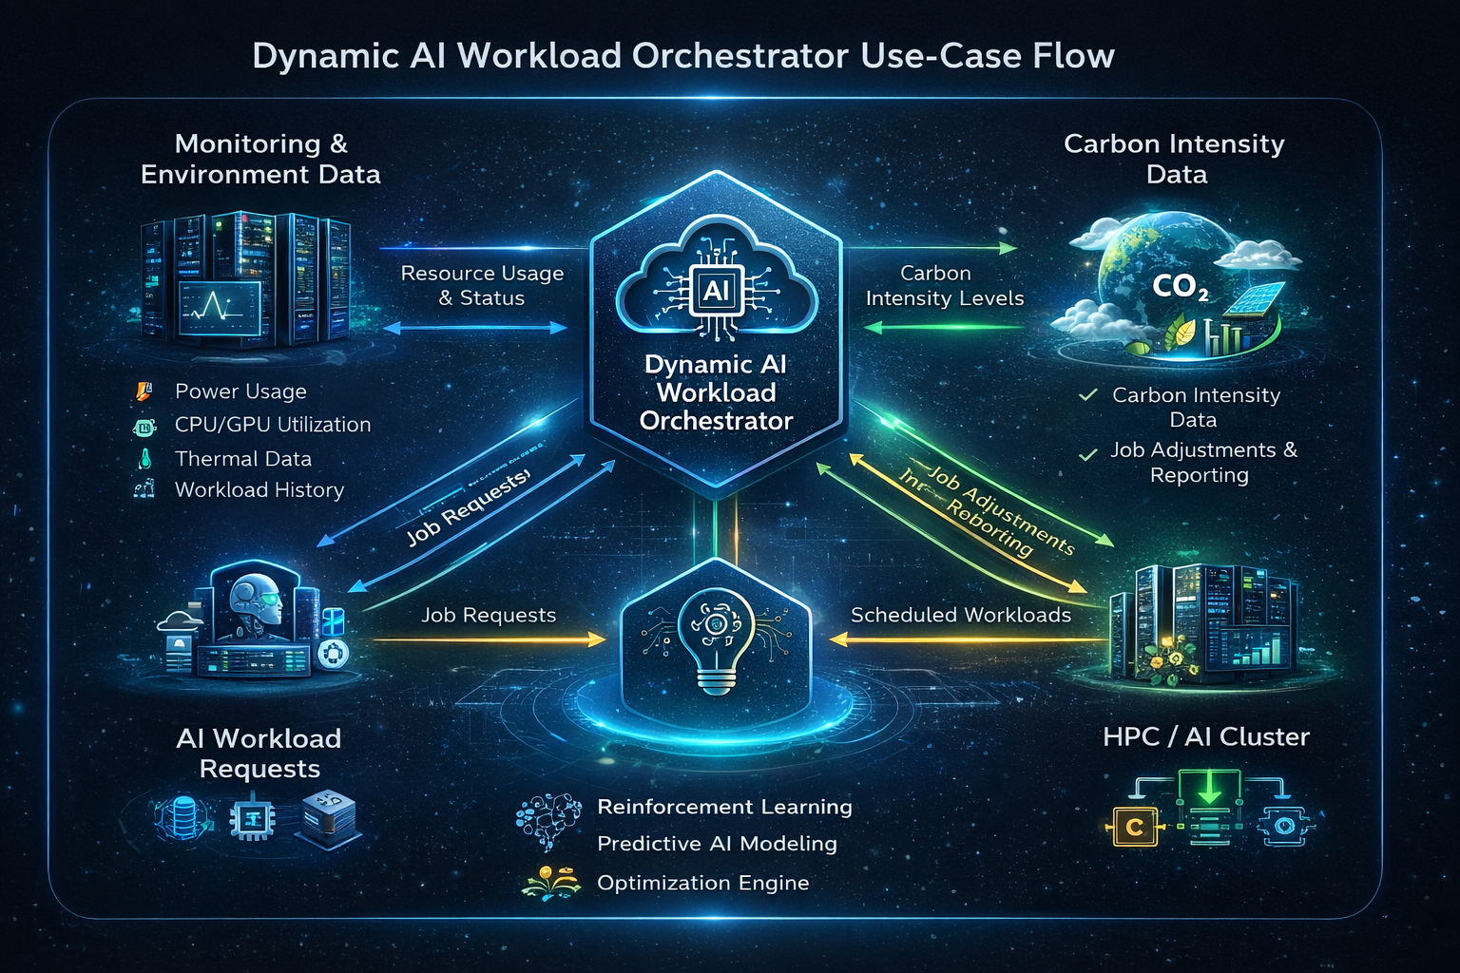
Process flow diagram or Use-case diagram

Slide 6
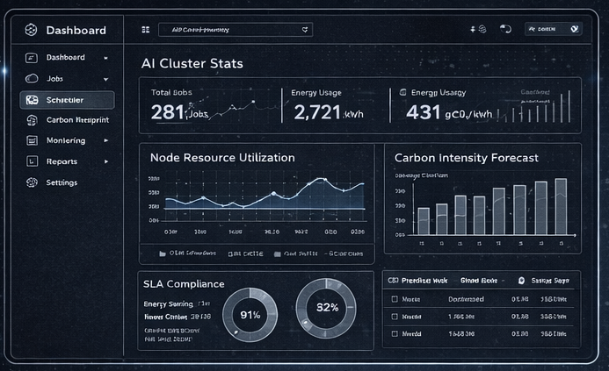
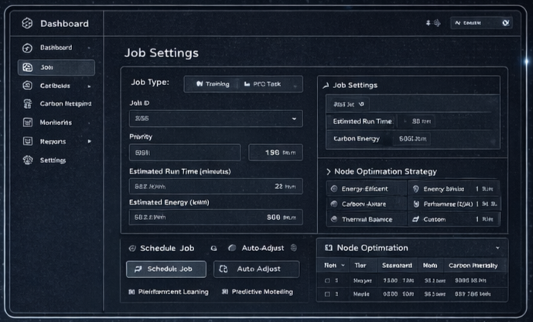
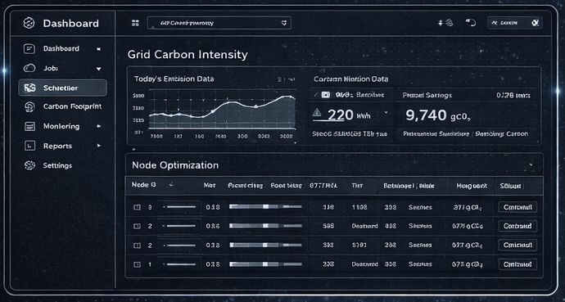
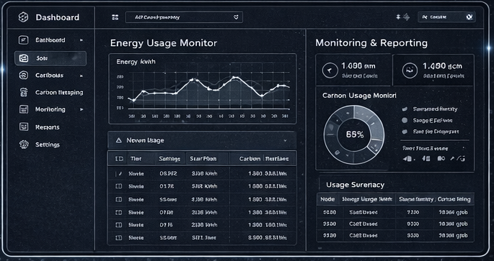
Wireframes / mock diagrams of the proposed solution
DASHBOARD
JOB SCHEDULING
CARBON AWARE SCHEDULER
MONITORING AND REPORTING

Slide 7
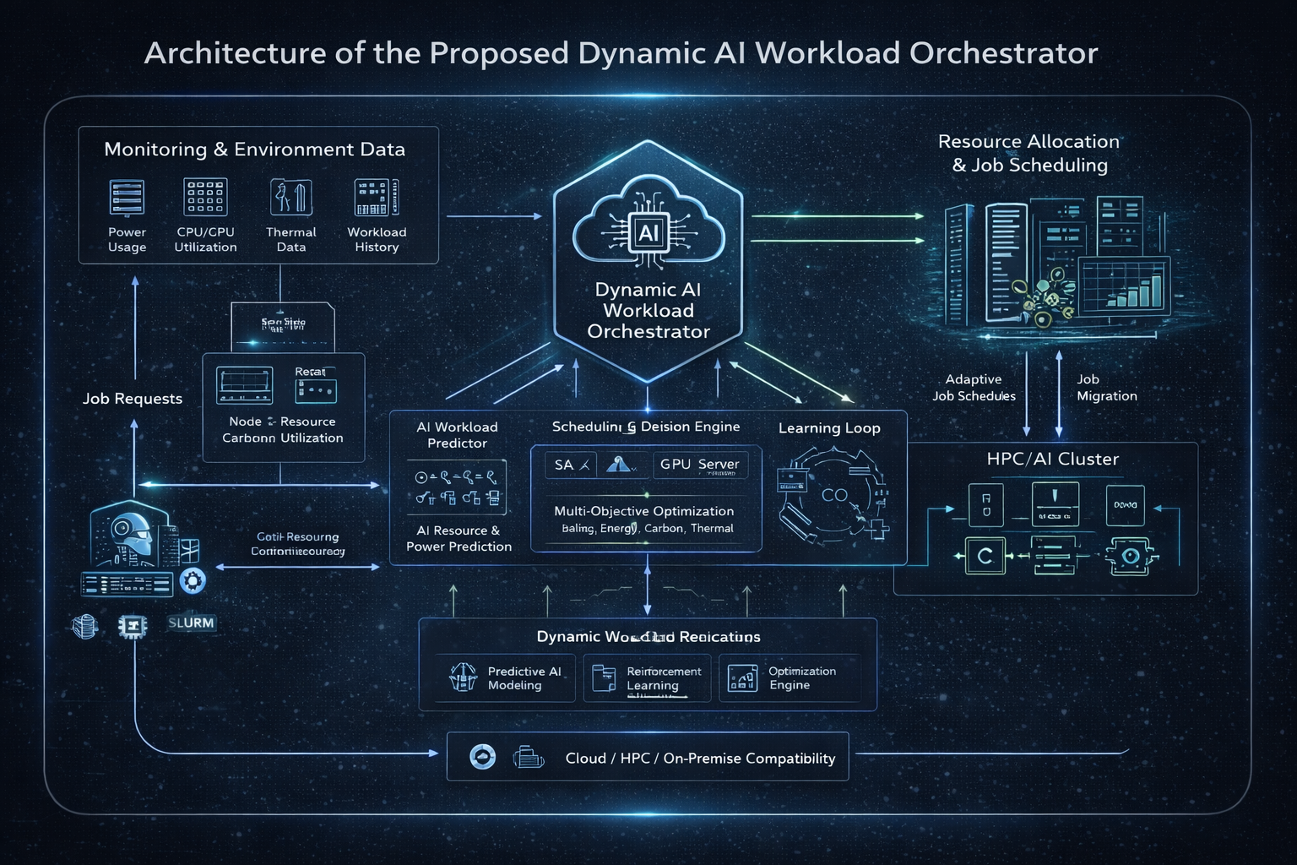
Architecture diagram of the proposed solution

Slide 8
Technologies to be used in the solution
⚙️ Optimization & Scheduling
Multi-Objective Optimization Algorithms
Genetic Algorithms / NSGA-II
Custom Scheduling Engine
Kubernetes Scheduler Extensions / Slurm API
🌱 Carbon & Energy Integration
Carbon Intensity APIs
Energy Modeling Libraries
Power Consumption Simulation Models
☁️ Infrastructure & Deployment
Docker (Containerization)
Kubernetes (Orchestration)
REST APIs (Fast API / Flask)
Cloud Integration (AWS / Azure / On-Prem HPC)
Chart.js / D3.js
🧠 AI & Machine Learning
Python
TensorFlow / PyTorch
Scikit-learn
Reinforcement Learning (Stable-Baselines / RLlib)
📈 Frontend Dashboard
React.js / Next.js
Tailwind CSS
📊 Data Processing & Monitoring
Prometheus (Metrics Collection)
Grafana (Visualization)
Pandas & NumPy (Data Analysis)
Real-time Telemetry APIs

Slide 9
Usage of AMD Products/Solutions
🖥️ AMD EPYC™ Processors
Used to run the AI-based scheduling engine and workload prediction models efficiently in high-core data center environments.
🎮 AMD Instinct™ GPUs
Used to accelerate reinforcement learning and optimization algorithms for intelligent workload orchestration.
⚙️ ROCm™ Software Platform
Used to enable GPU-accelerated AI model training and integration with PyTorch/TensorFlow frameworks.

Slide 10
Estimated implementation cost
🧠 Development Cost
AI Model Development & Optimization Engine
Backend & Scheduler Development
Dashboard & UI Development Estimated: $8,000 – $12,000
🛠 Software & Tools
Open-source frameworks (Python, PyTorch, Kubernetes)
Minimal licensing cost Estimated: $0 – $1,000
☁️ Infrastructure & Cloud Cost (Prototype Phase)
Cloud compute instances (CPU + GPU)
Storage & Monitoring services Estimated: $2,000 – $5,000

Slide 11
Add as per the requirements of the contest
📈 20% Energy Reduction
AI-driven scheduling reduces power consumption during large-scale AI workloads.
🌱 18% Carbon Emission Decrease
Carbon-aware node selection minimizes environmental impact without affecting performance.
⚡ 15% Higher Cluster Utilization
Intelligent workload distribution maximizes resource efficiency.
💰 Reduced Operational Costs
Optimized compute allocation lowers electricity and infrastructure expenses.
🚀 Scalable SaaS Deployment Model
Designed for seamless integration across enterprise and cloud HPC environments.

Slide 12


